Slide 1
National Rural Employment Guarantee Act (NREGA)
Project #3, Visual Presentation, 2024-22-06

Slide 2
What is NREGA?
An Indian Social welfare Scheme
To enhance the livelihood security of rural households
To provide at least 100 days of guaranteed wage employment in a financial year
Target groups: Rural area, Schedule Castes. Scheduled Tribes, Woman-headed household, and other marginalized groups
-Ministry of Rural Development”Govt. Of India”

Slide 3
What this Project about?
This project is given by Mentorness as data analysis and Visualization presentation of real-world scenario datasets.
To gain valuable insights into the implementation and impact of NREGA
By using Tableau or Power BI to investigate trends and states to answer some problem statements

Slide 4
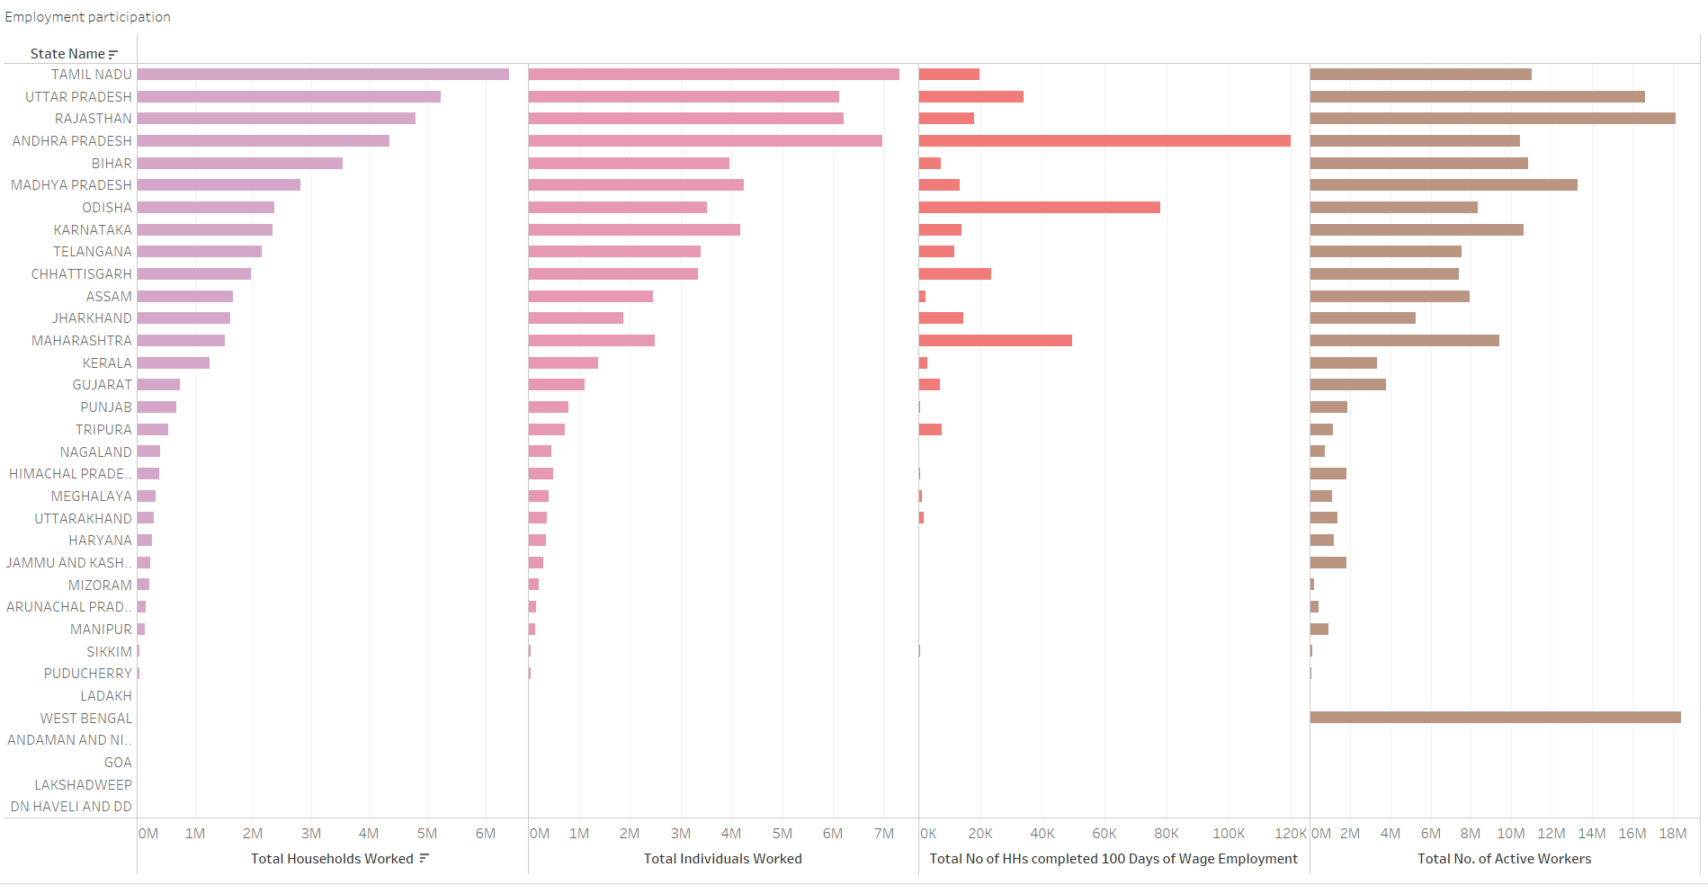

Slide 5
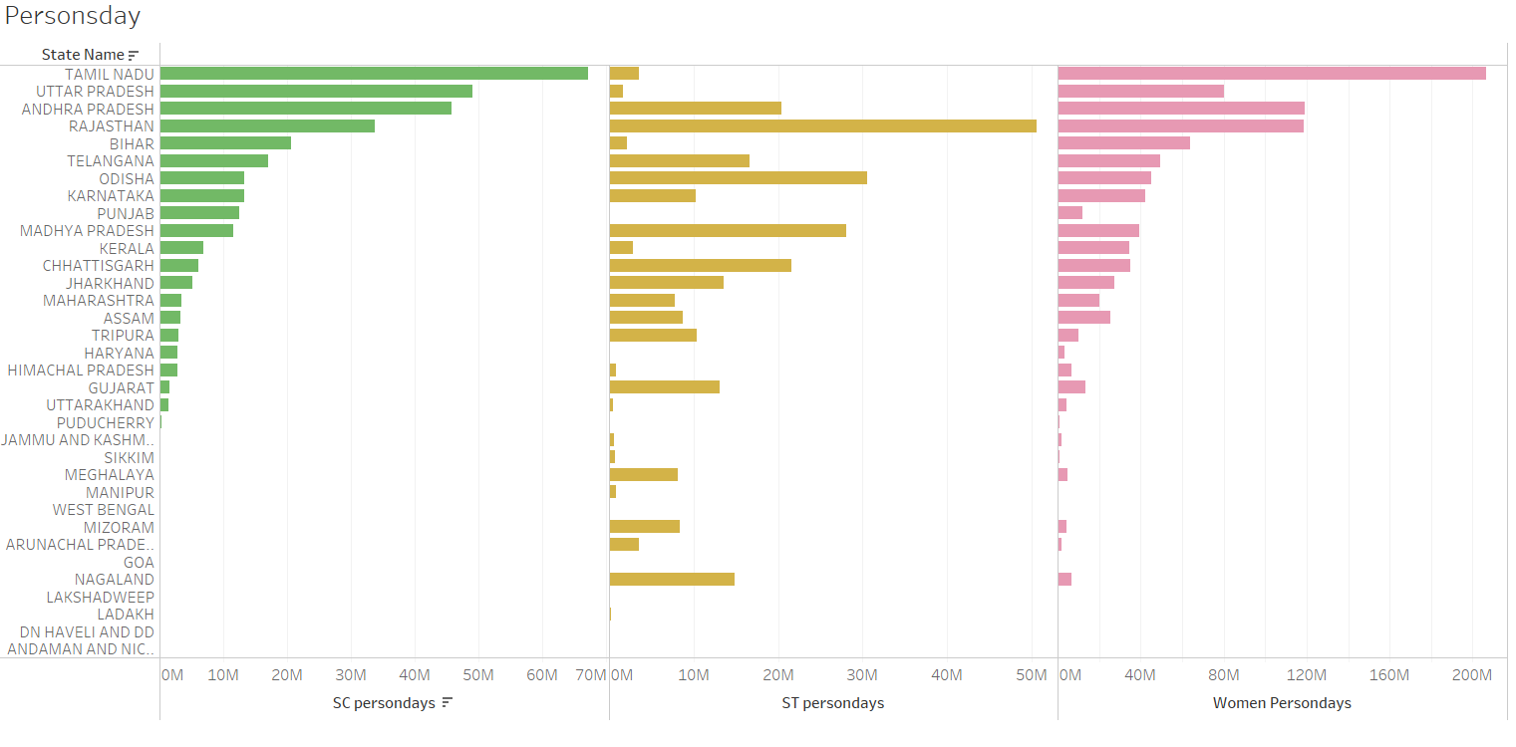

Slide 6
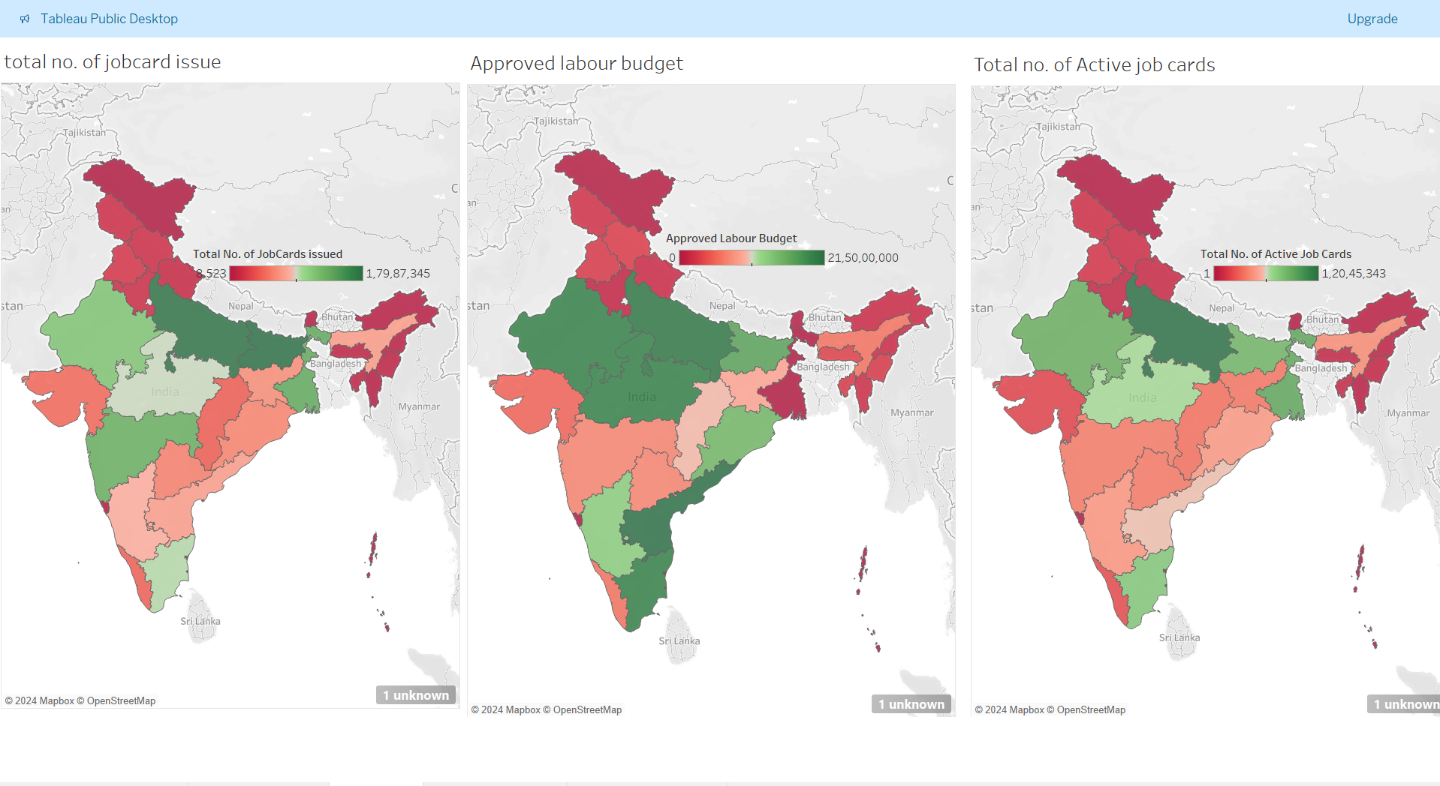

Slide 7
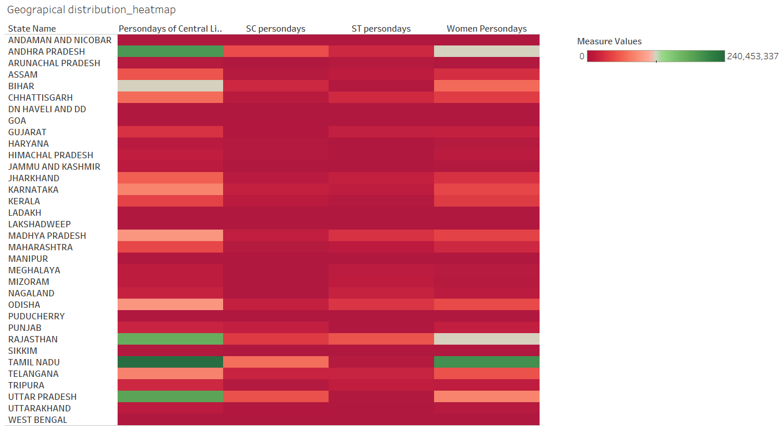

Slide 8
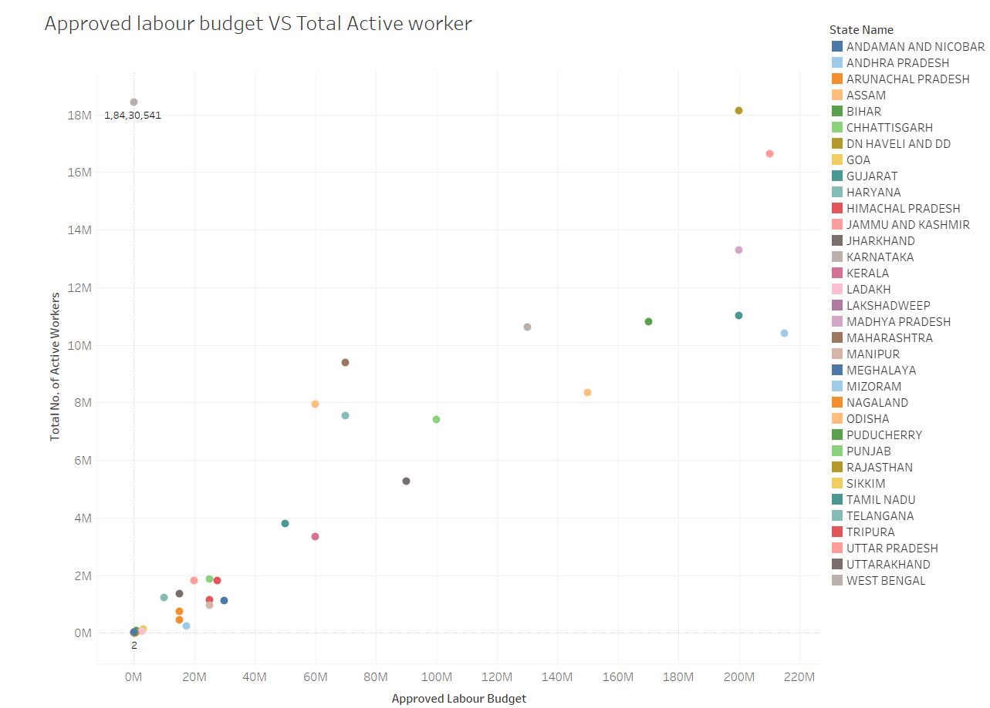

Slide 9
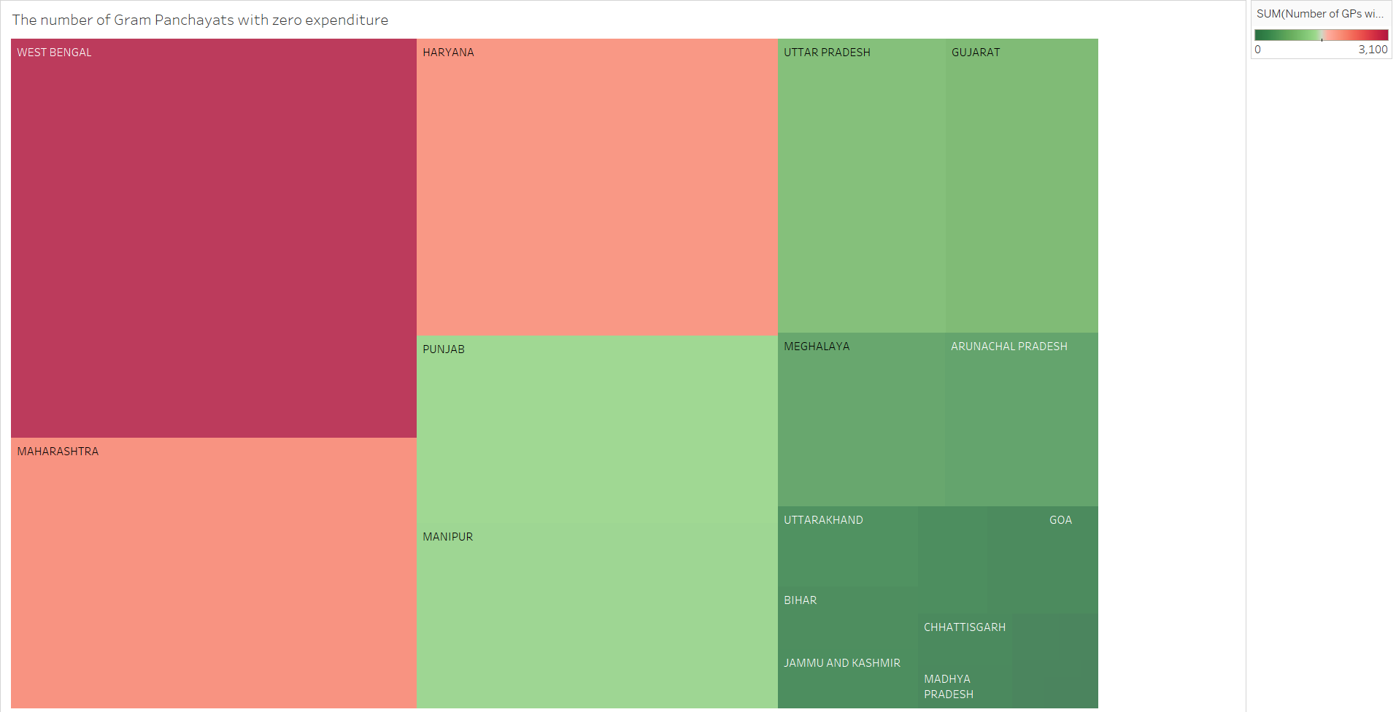

Slide 10
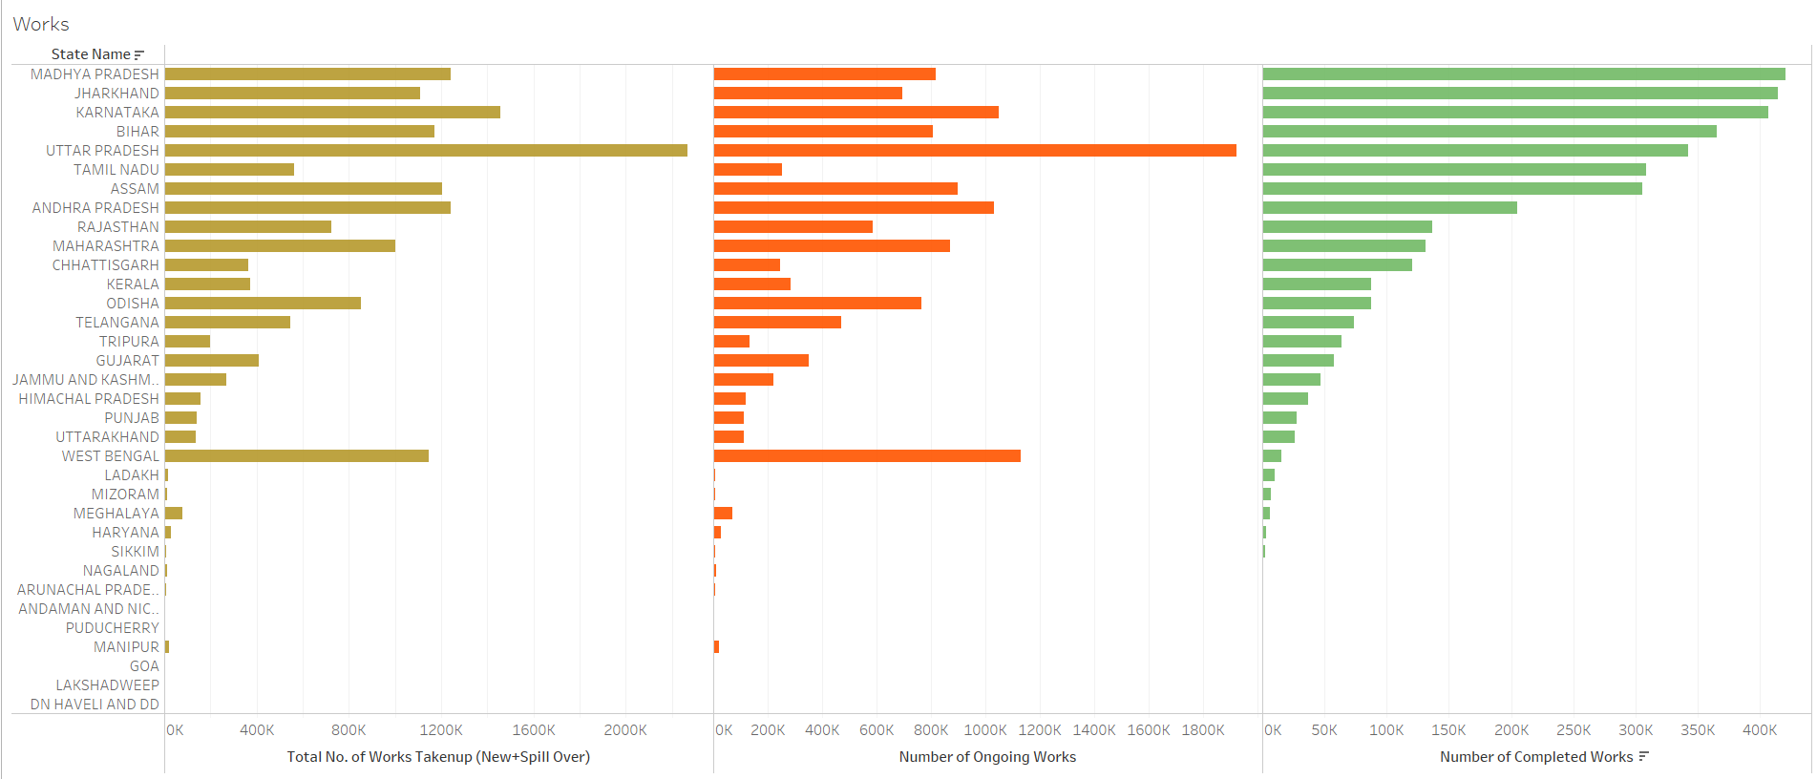

Slide 11
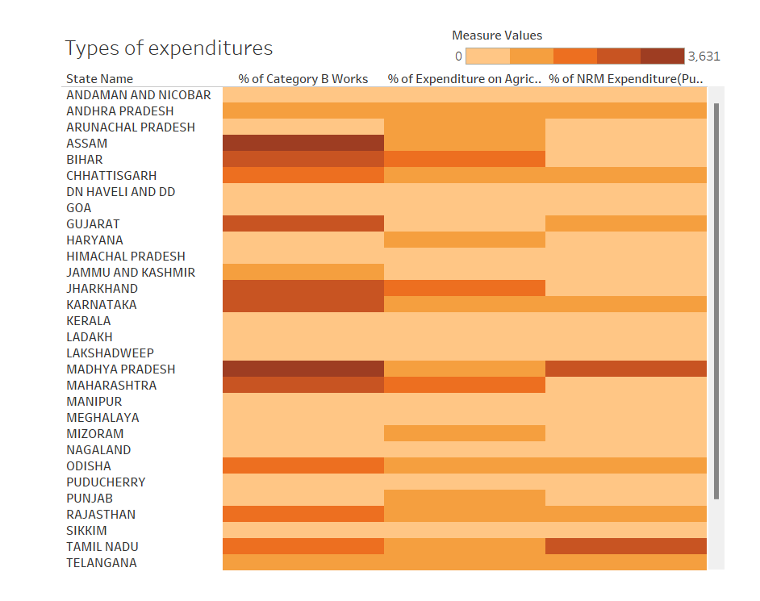

Slide 12
Thank You

